Slide 1
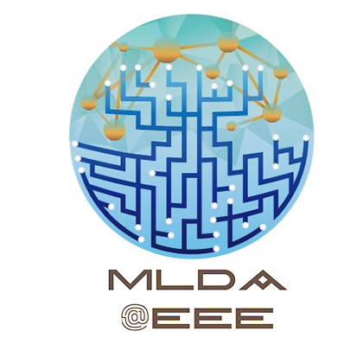
Edge ML: From Cloud to Your Fingertips
Instructors: Philip, Yong Hao

Slide 2
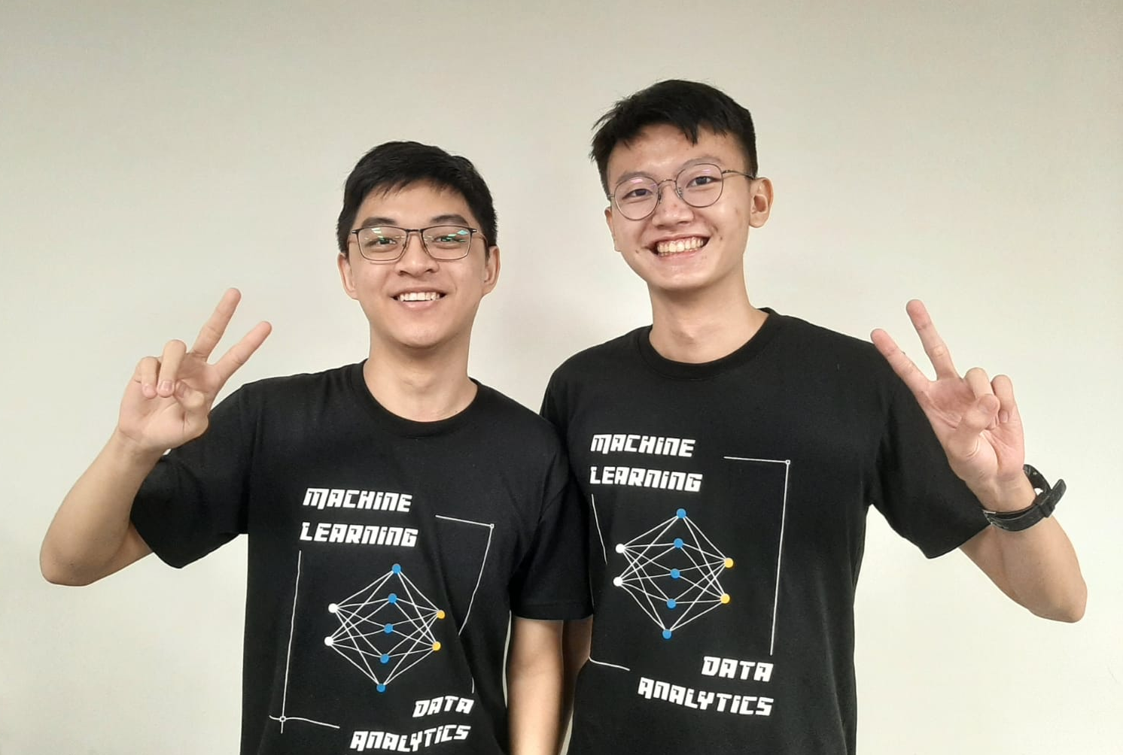
Insert happy photo here, totally not stressed

Slide 3
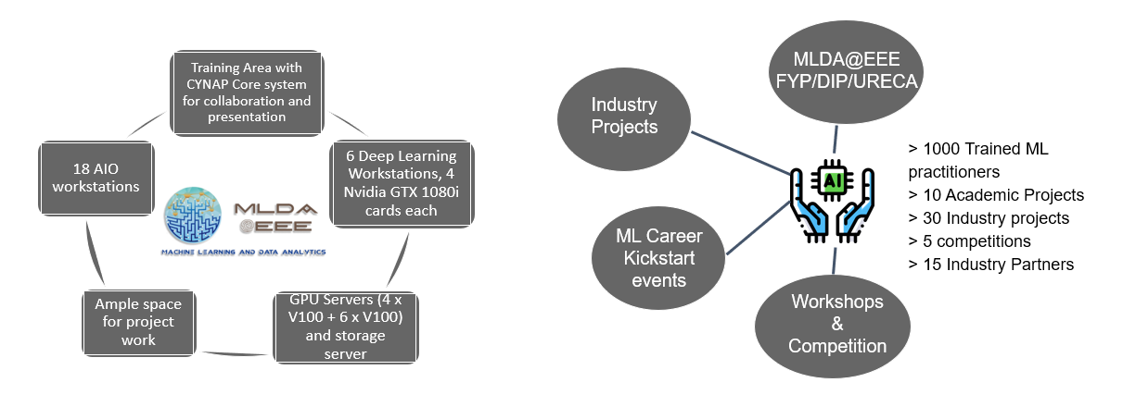
MLDA’s Mission
Provide an integrated platform for EEE/IEM students to learn and implement Machine Learning, Data Science & AI, as well as facilitate connections with the industry.

Slide 4

Edge ML: New possibilities through machine learning directly on microcontrollers

Slide 5
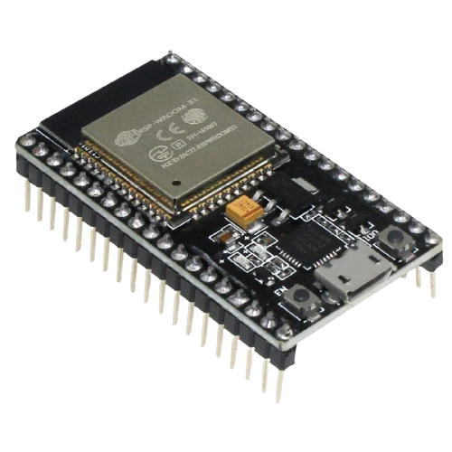
Workshop Outline
Part 1
What and Why?
Special Techniques
Recent Developments
Part 2
Demo Session with ESP32
Google Colab Demo
Hands on with Edge Impulse

Slide 6
Edge ML
What and Why?

Slide 7
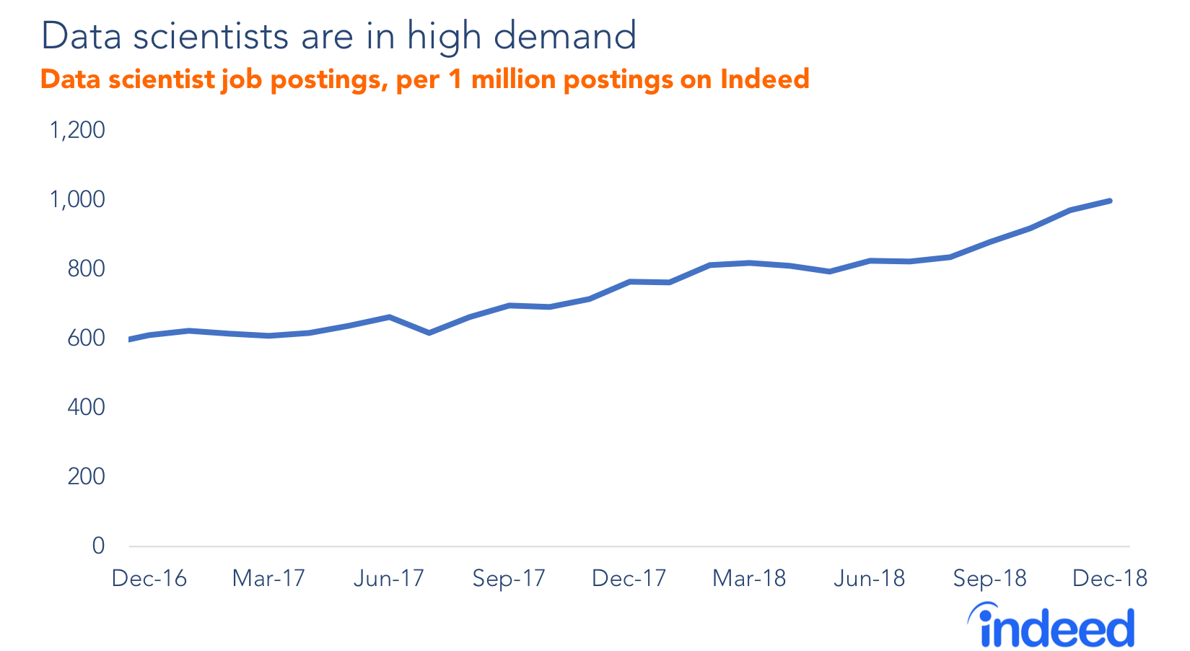
We are shifting to a data-centric world
Estimates: We generate 145 trillion MB per day!
Many companies use data to improve their business / product / service.
Notes:
https://techjury.net/blog/how-much-data-is-created-every-day/

Slide 8
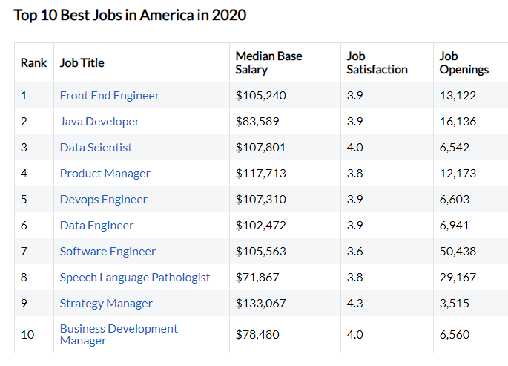
We are shifting to a data-centric world
Estimates: We generate 145 trillion MB per day!
Many companies use data to improve their business / product / service.
Notes:
https://techjury.net/blog/how-much-data-is-created-every-day/

Slide 9
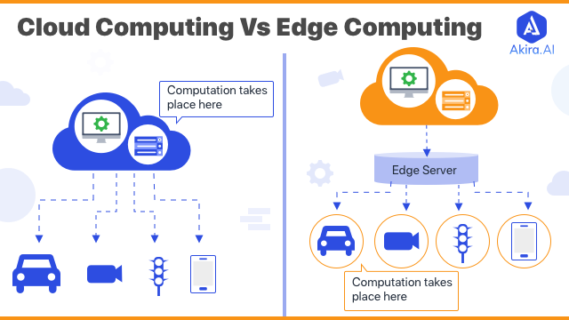
Notes:
https://www.akira.ai/blog/edge-computing-vs-cloud-computing/

Slide 10
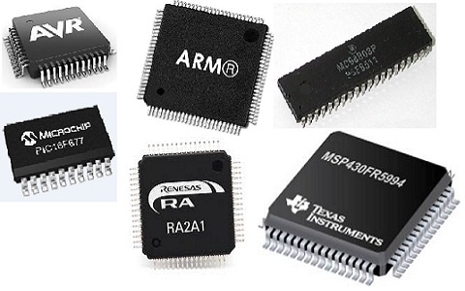
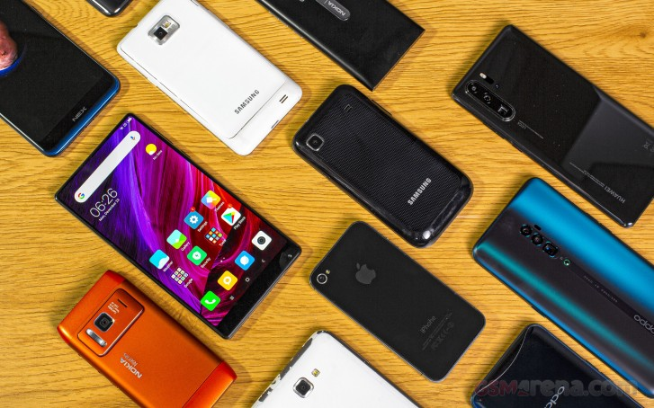
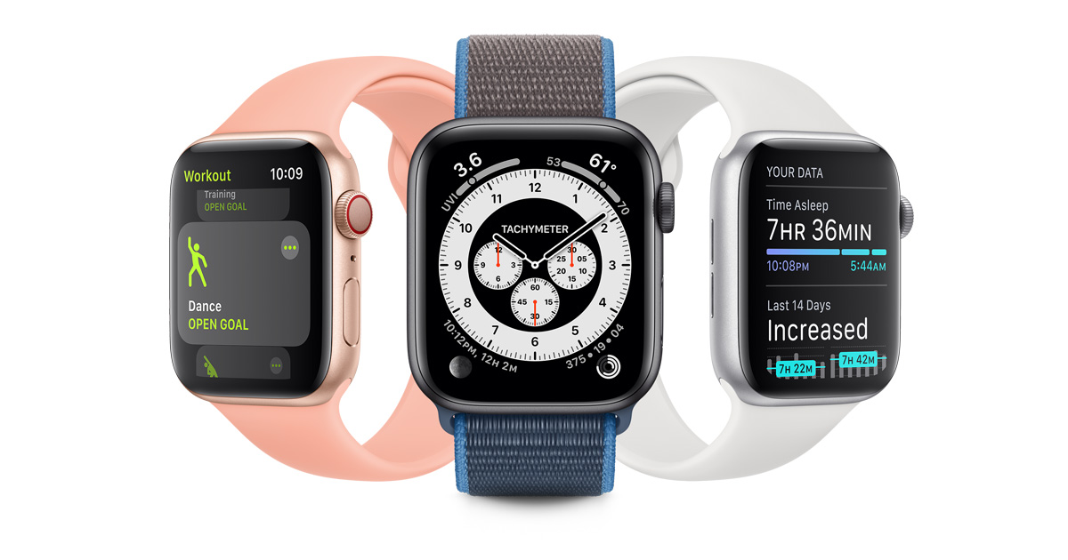
Edge Devices
and
many
more
...

Slide 11
Rule-based → Probabilistic-based
Application of Microcontroller in Day to Day Life Devices:
Light sensing & controlling devices.
Temperature sensing and controlling devices.
Microcontroller with ML / AIoT
Sensor fusion to report health statistics / emergency alerts (connectivity not needed)
Pattern / object detection of objects on conveyor belt

Slide 12
Benefits of Edge Computing / AI
Support for low-latency use cases and fast response times
Resilience against connectivity issues - Many areas have slow / no internet connection
Lower costs:
Upfront: Embedded devices
Long-term: Network Bandwidth, Cloud, Energy
Notes:
Performing predictions without depending on the cloud or external services. The models become a part of the firmware flashed into the devices.

Slide 13
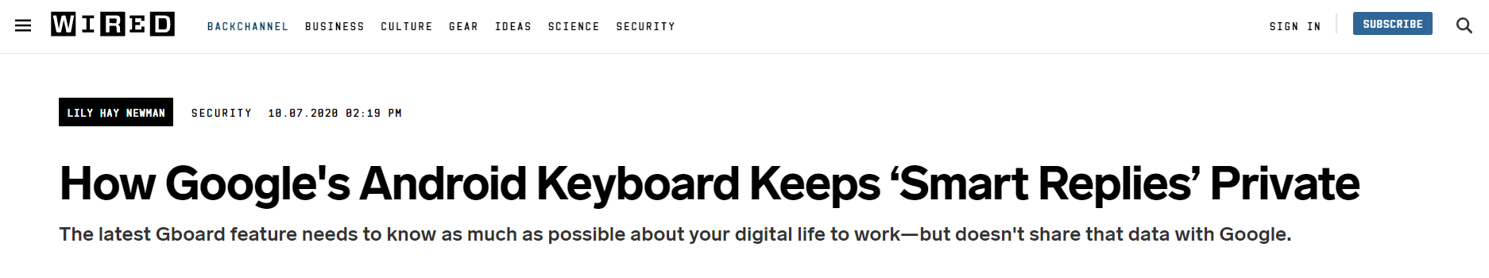
Benefits of Edge Computing / AI
Data Privacy and Security
Personalised data kept locally only - Eg. GBoard

Slide 14
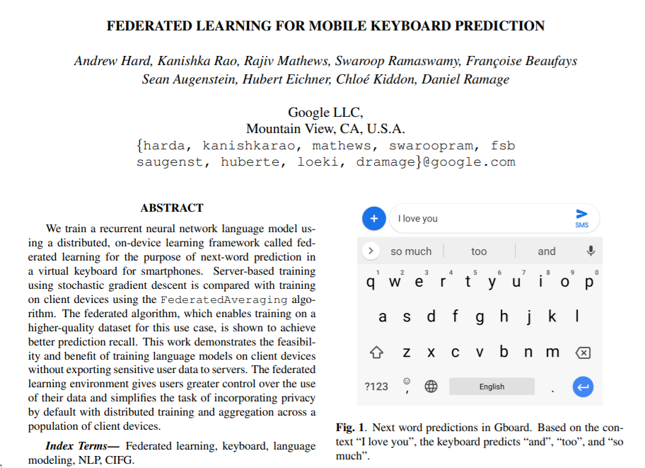
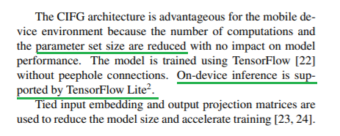
https://arxiv.org/abs/1811.03604

Slide 15
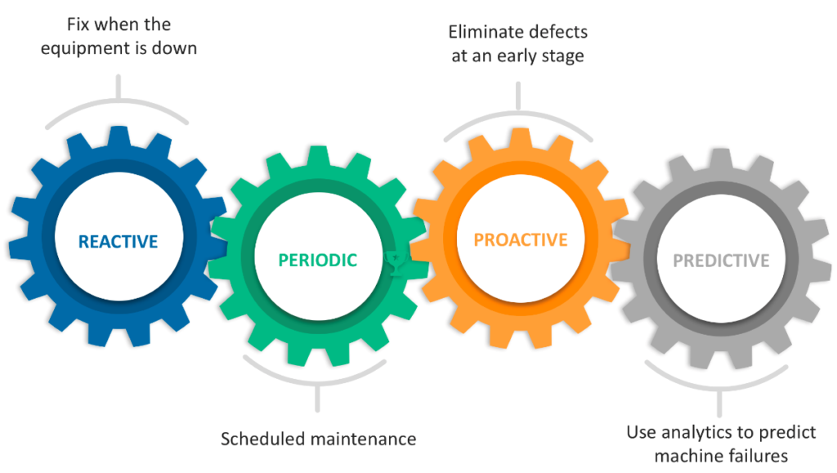

Industry 4.0 Shifts
1) NVIDIA introducing on-device GPU in 2) Manufacturing industry: Predictive maintenance security cameras for local detection. → Jetson TX2 embedded AI supercomputer

Slide 16
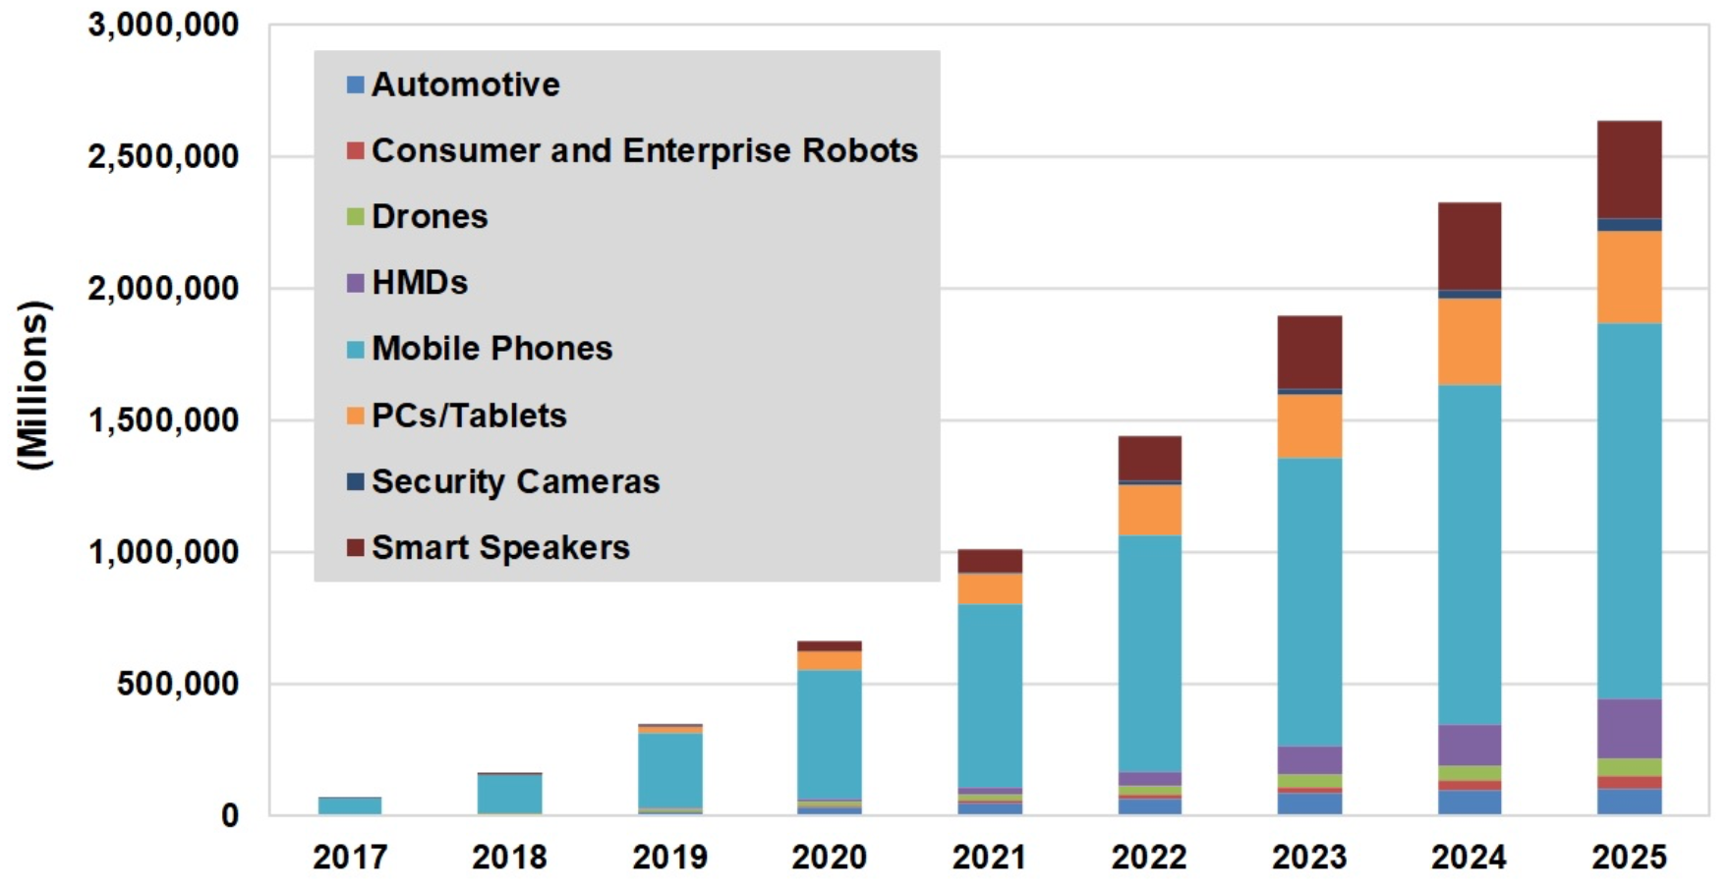
AI Chip Architectures Race To The Edge
Notes:
https://semiengineering.com/ai-chip-architectures-race-to-the-edge/

Slide 17
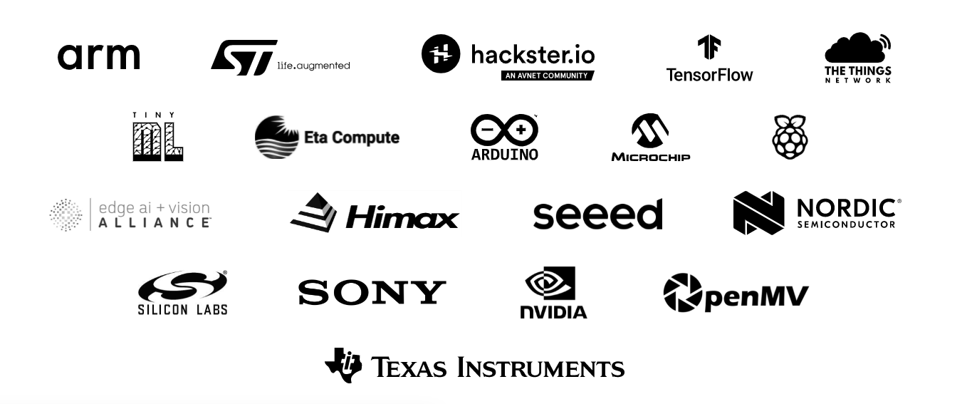

Slide 18
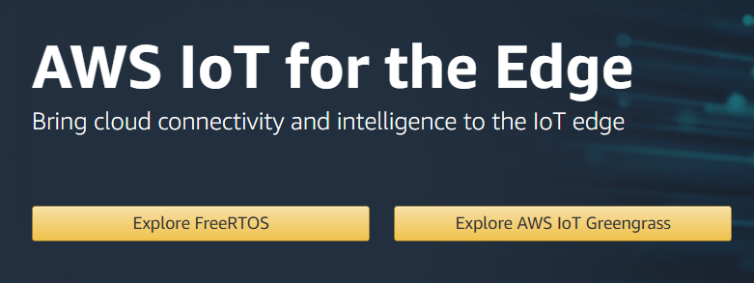
Edge AI will not completely replace Cloud!
Edge will work in complement with the Cloud
User data can be ‘sanitised’ before uploading to Cloud
Eg. Data collection, Federated learning
High demand computational tasks will still need Cloud
Cloud based entities are investing in Edge too
Complement service

Slide 19
Edge ML
Special Techniques

Slide 20
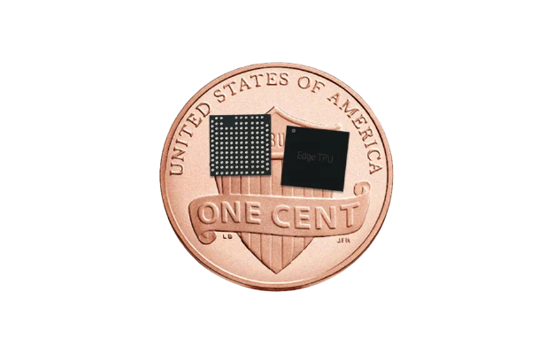
What are the challenges? Why only now?
Low compute resources
No parallelism during model inference (pure CPU based)
Moore’s law
Specialised chips - Google’s Edge TPU, AI SOCs

Slide 21
Remember to check back model performance!
If optimization steps causes model performance to suffer, then investigate …
Further reading:
https://www.oreilly.com/content/compressing-and-regularizing-deep-neural-networks/
https://blog.dataiku.com/making-neural-networks-smaller-for-better-deployment-solving-the-size-problem-of-cnns-using-network-pruning-with-keras

Slide 22
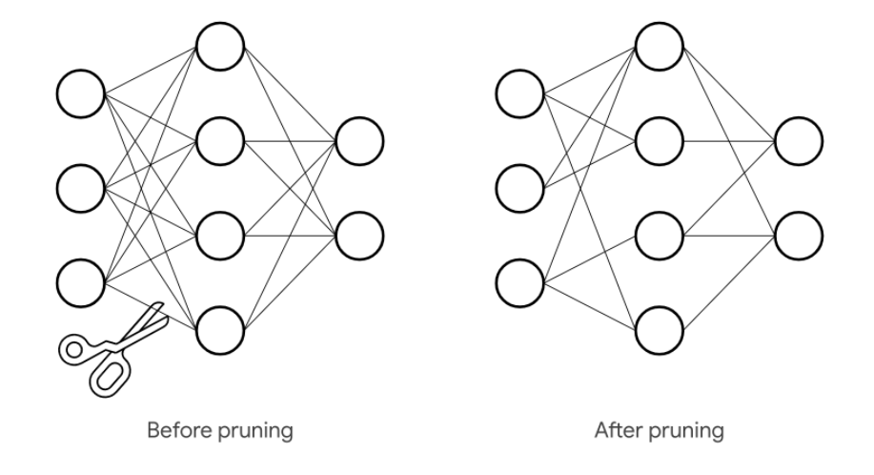
Technique 1 - Weight Pruning
Reduce the number of parameters and operations involved in the computation by removing connections, and thus parameters, in between neural network layers.

Slide 23
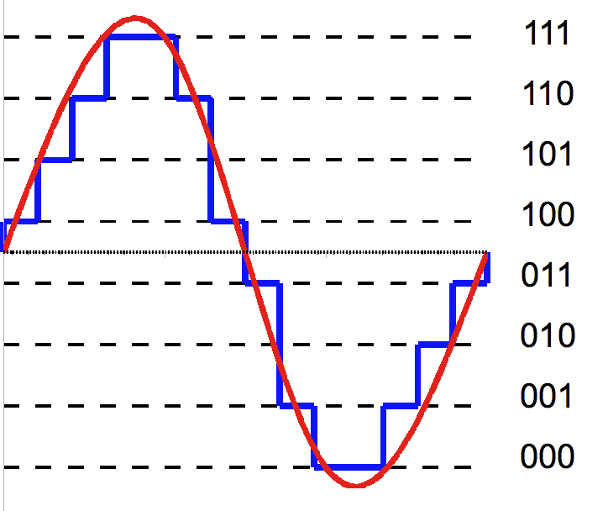
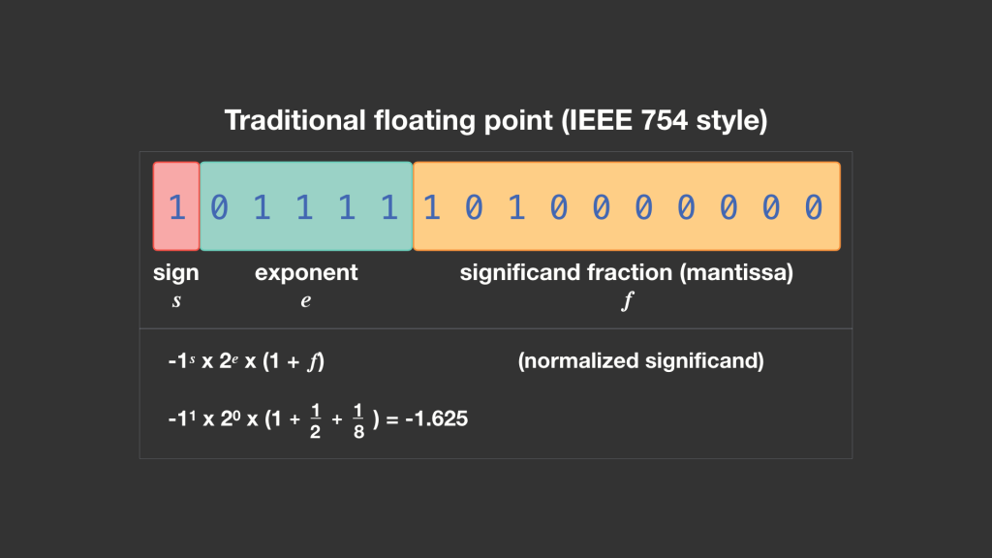
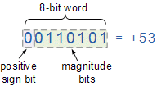
Technique 2 - Quantization
Integer quantization is a general technique that reduces the numerical precision of the weights and activations of models to reduce memory and improve latency.

Slide 24
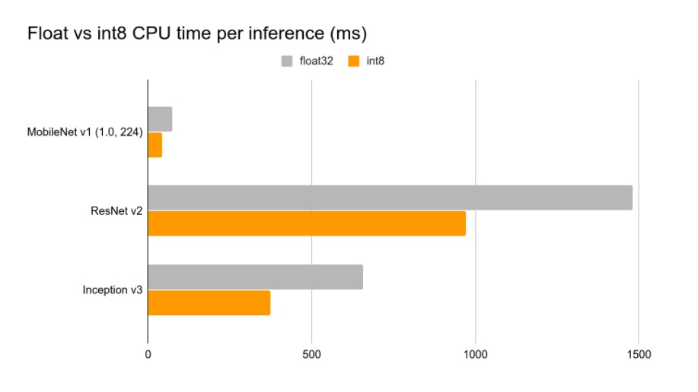
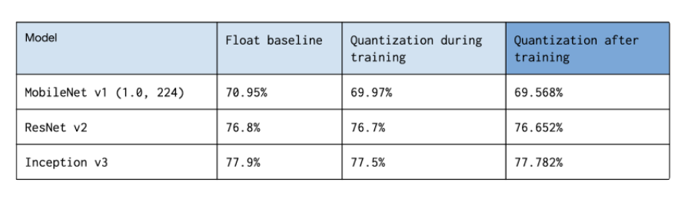
Technique 2 - Quantization
Int is more efficient!

Slide 25
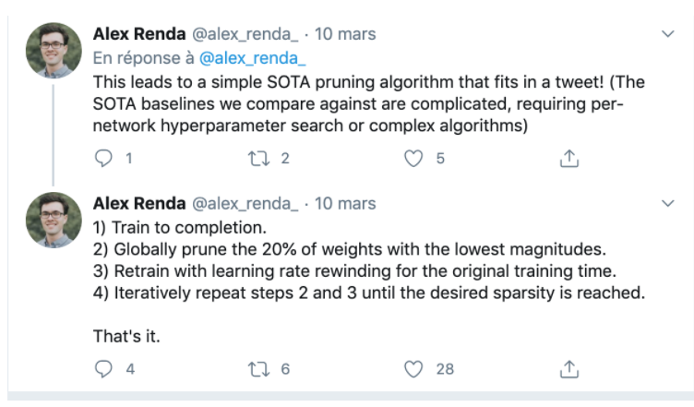
Technique 3 - Network Pruning: Rank-Prune-Retrain
Applied as a general technique not just for Edge ML
Reduced complexity of model
Reduced number of parameters

Slide 26
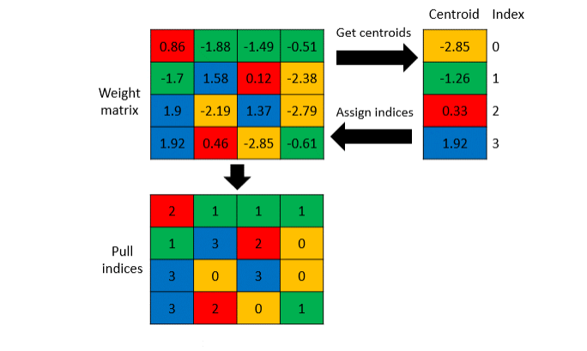
Technique 4 - Weight Clustering
Reduces the size of your model by replacing similar weights in a layer with the same value

Slide 27

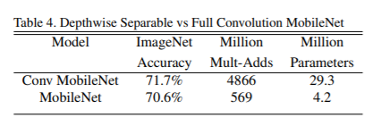
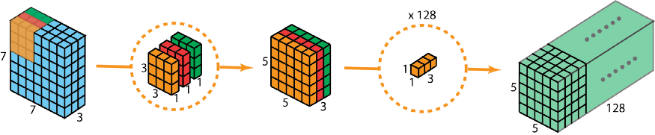
Specially-designed Model Architectures
MobileNet: Depth-wise Separable Convolutions
https://arxiv.org/abs/1704.04861

Slide 28
Edge ML
Deployment - Steps and Frameworks

Slide 29
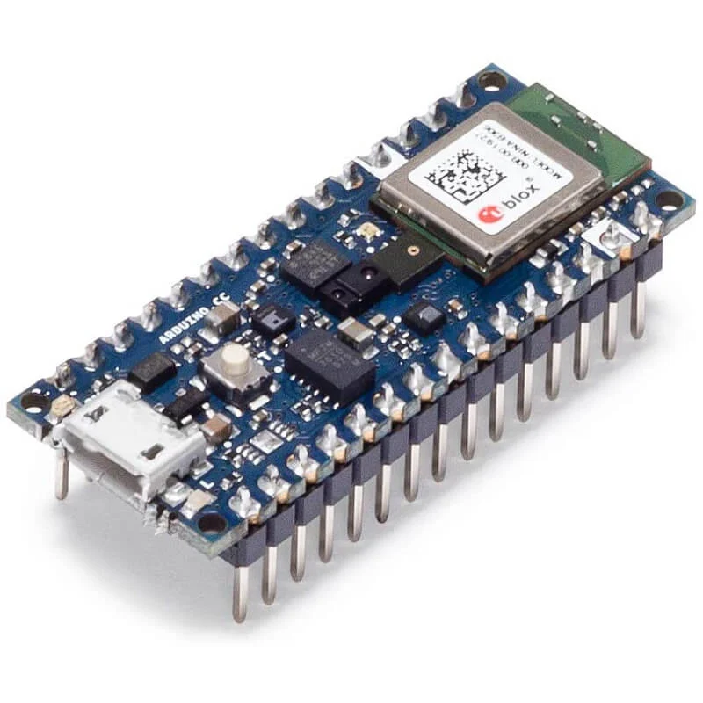
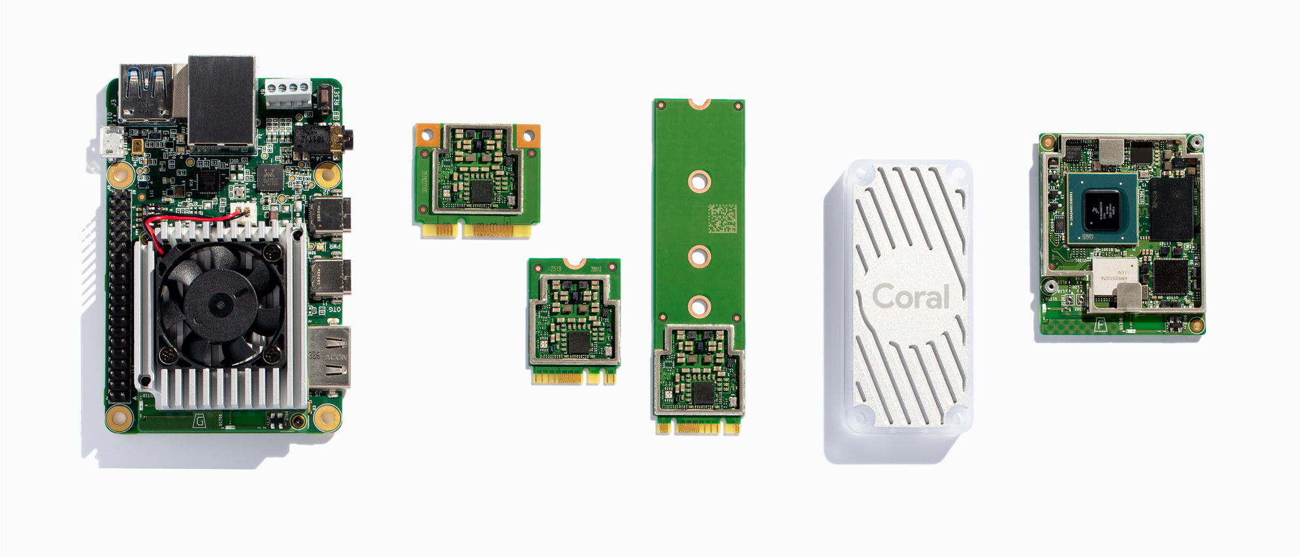
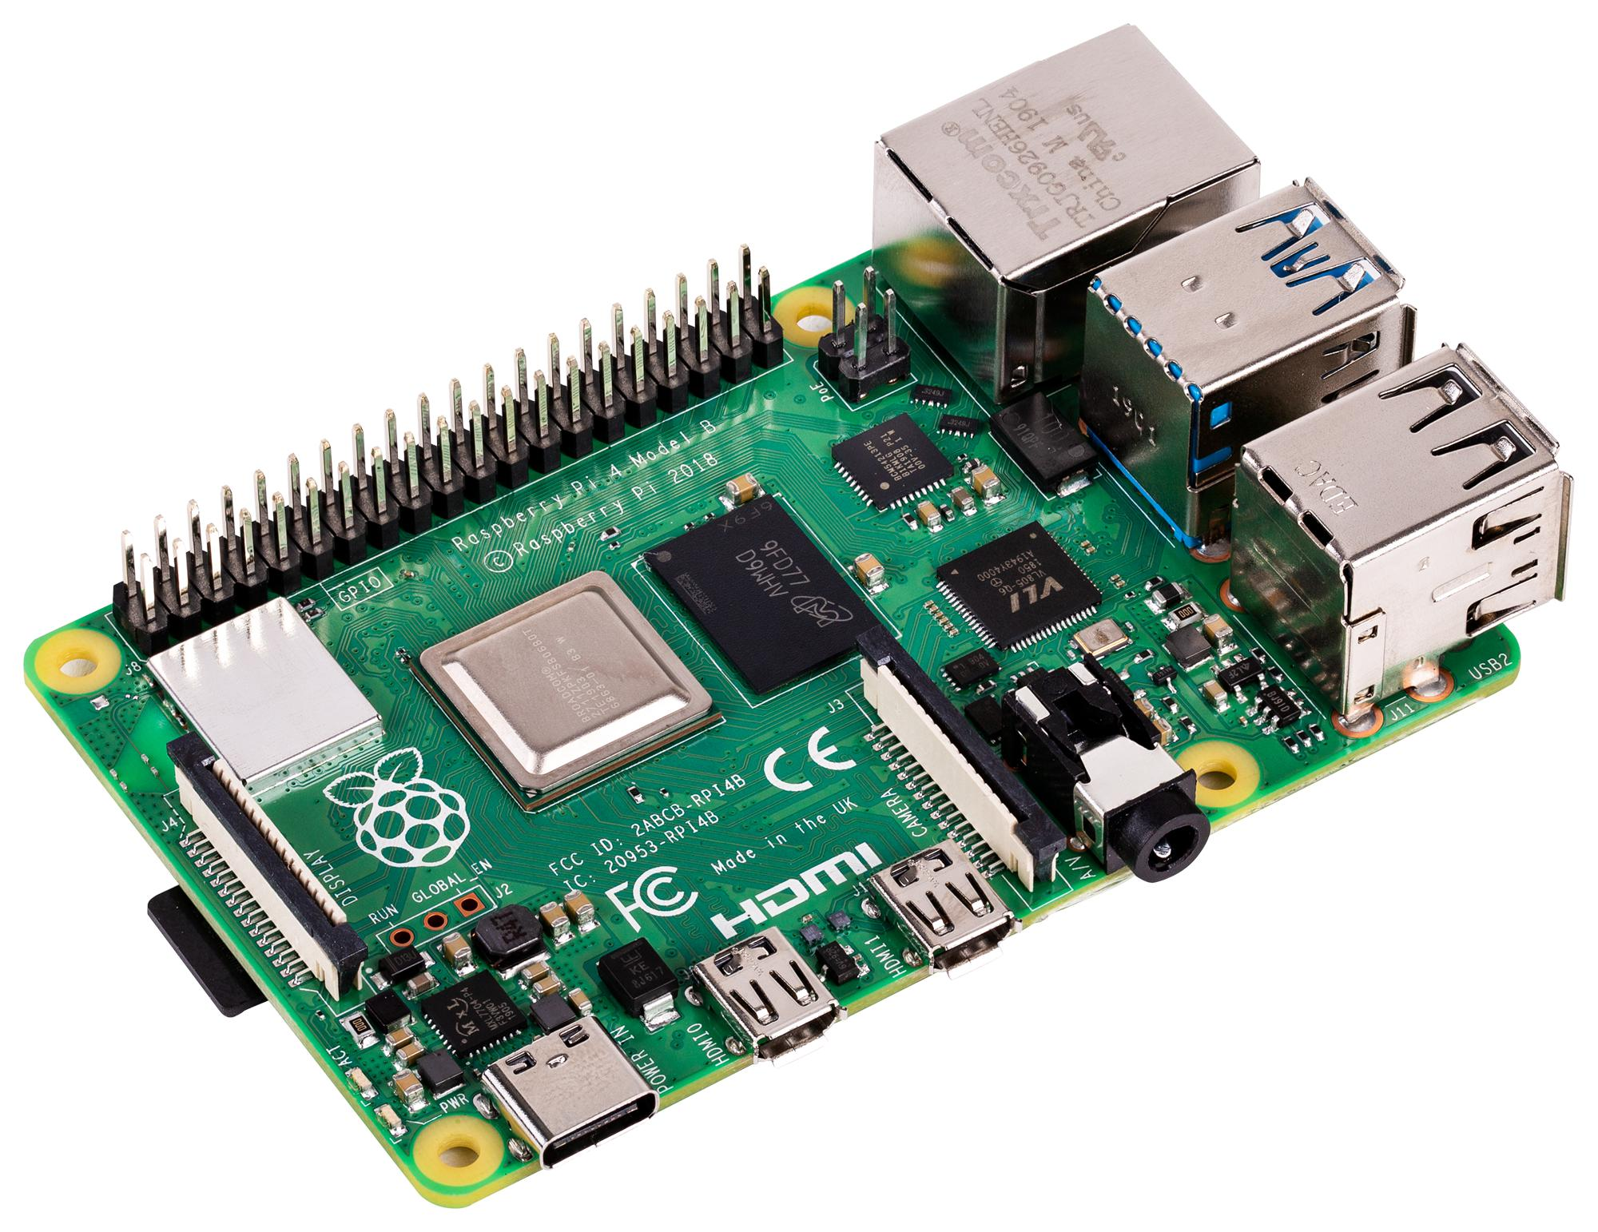
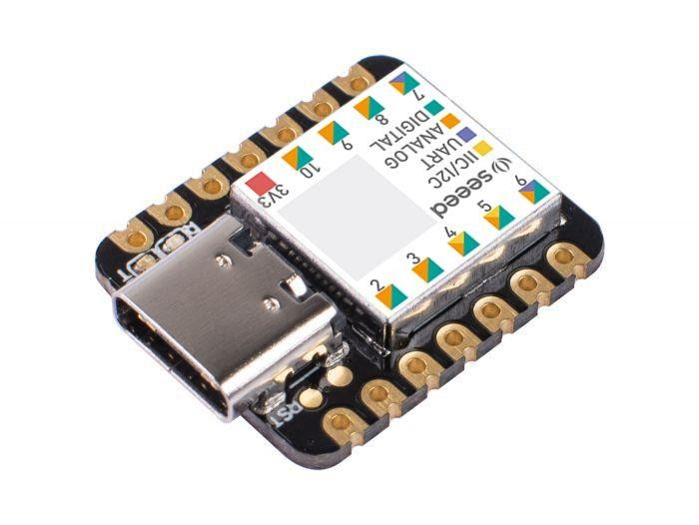
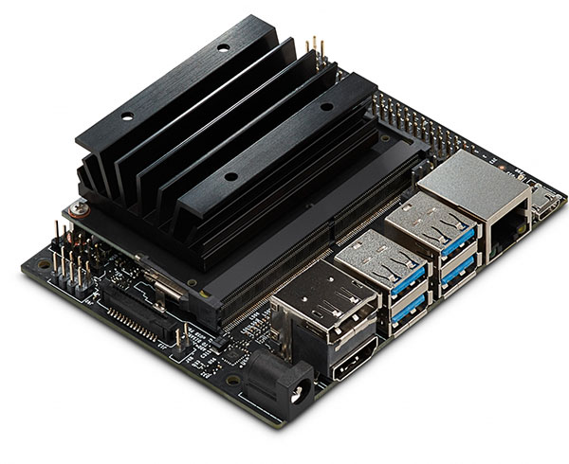
Edge Devices
Coral SoM
Raspberry Pi 4
Arduino Nano 33 BLE Sense
Nvidia Jetson Nano
Seeeduino XIAO
AI Hardware Accelerators
Microcontrollers
Micro-computer

Slide 30
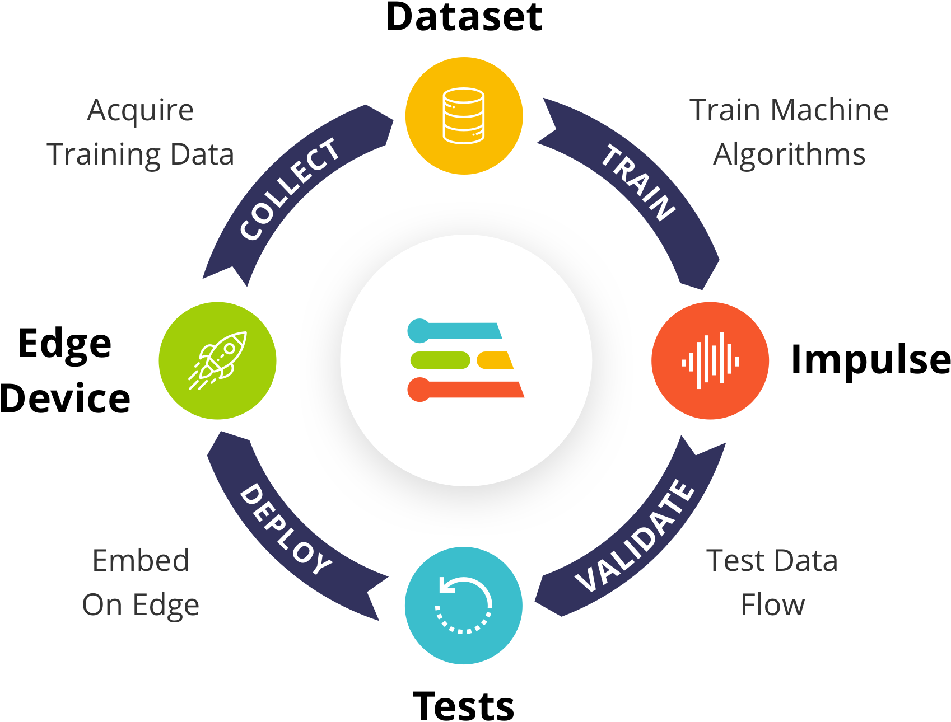
What are the common steps to deploy edge ML?
1. Collecting, exploring, and evaluating dataset
2. Feature engineering (digital signal processing) -> Heavylifting
3. Training and evaluating machine learning model
Notes:
https://www.edgeimpulse.com/

Slide 31
What are the common steps to deploy edge ML?
4. Size and efficiency optimization of model (most commonly quantization)
5. Deployment (commonly C++ library) with required operator kernels
6. Writing and tuning an application that interprets the model’s output and uses it to make decisions.
Notes:
https://www.edgeimpulse.com/

Slide 32

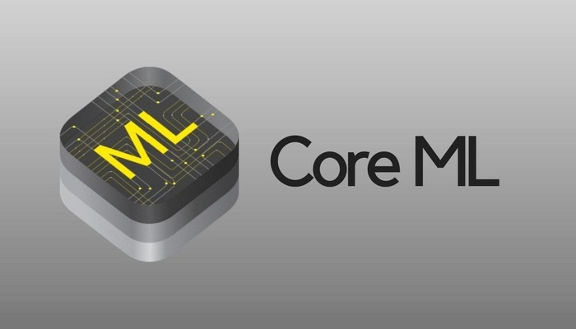
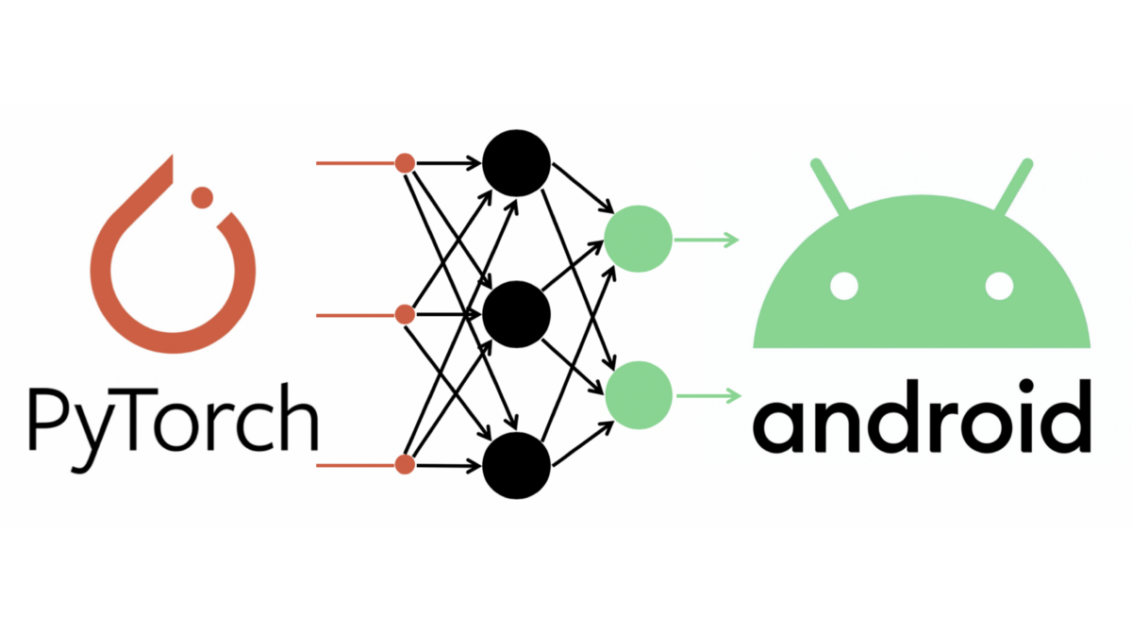
Common frameworks for TinyML models
TensorFlow Lite
CoreML (Apple library)
PyTorch Mobile (Facebook’s Pytorch Deep Learning Library)

Slide 33
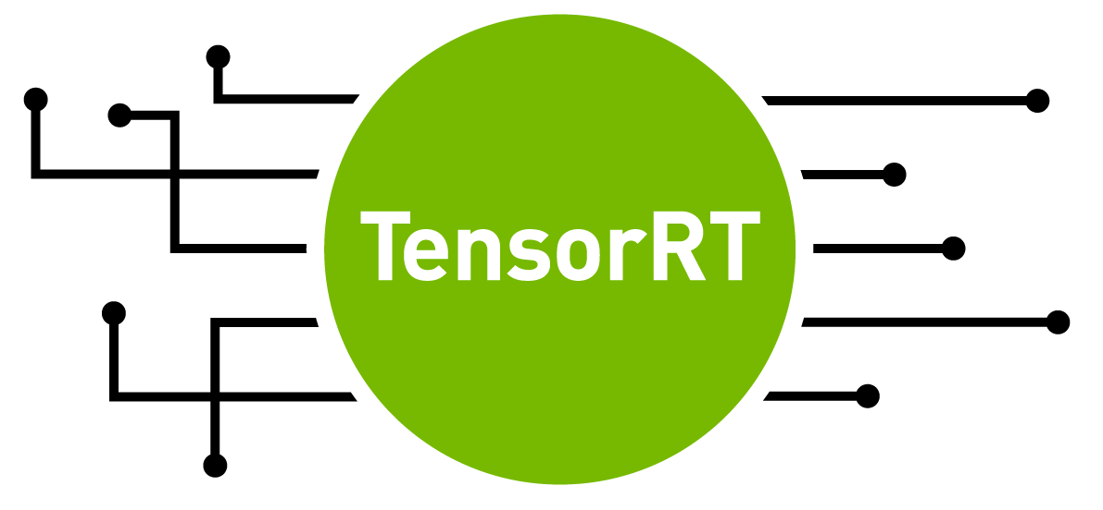



Other Edge ML Technologies
ONNX
TensorRT (Nvidia)
Openvino (Intel)
Tensorflow.js (Javascript)

Slide 34

Edge Impulse
AutoML
TinyML
Data Acquisition
Prediction
Conversion
Optimization

Slide 35

Edge Impulse
Advanced DSP blocks
Latency and Memory Usage Estimate
Direct compilation to C++ Source Code
Generates important features from raw sensor data
Reduce feature engineering workload for neural network model
Comparison can be done before deployment and changes can be made immediately
No interpreter needed
Shifts data easily into ROM
Linker knows exactly which operations are being used

Slide 36
Break Time!
Please make an Edge Impulse account (on PC, not mobile):
https://www.edgeimpulse.com/

Slide 37
Edge ML
Demo Session with ESP32

Slide 38
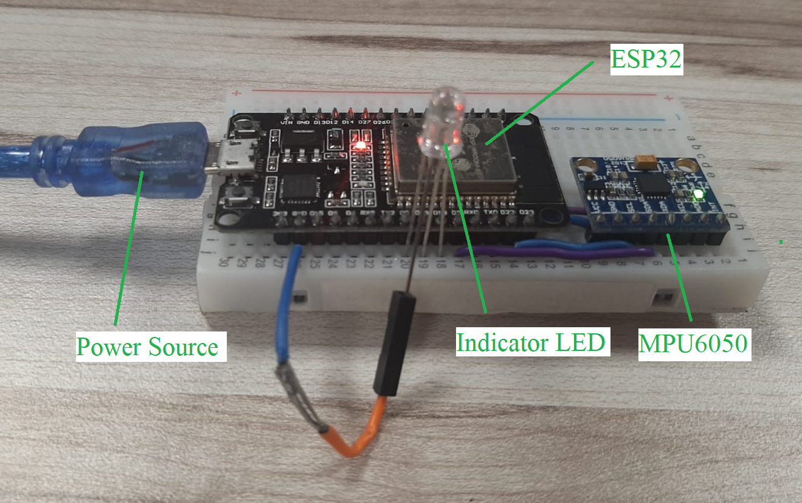
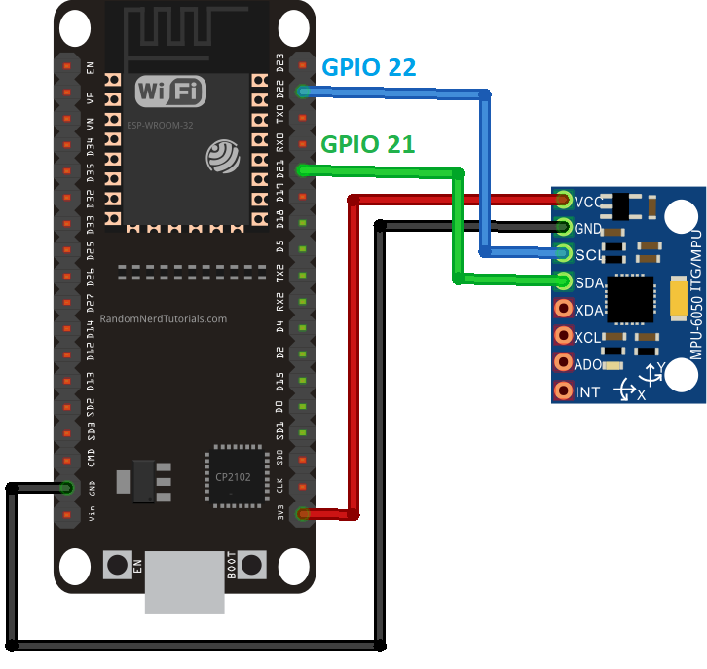
Gesture Recognition on ESP32

Slide 39
Pin Diagram
https://www.hackster.io/Yukio/gesture-classification-with-esp32-and-tinyml-dab252

Slide 40
Edge ML
Google Colab Demo

Slide 41

Flower Classification with TFLite Model Maker
https://colab.research.google.com/drive/1iXDz6r9kLeQ6xjJ1O0F-iV8LZ9A_MV8x

Slide 42
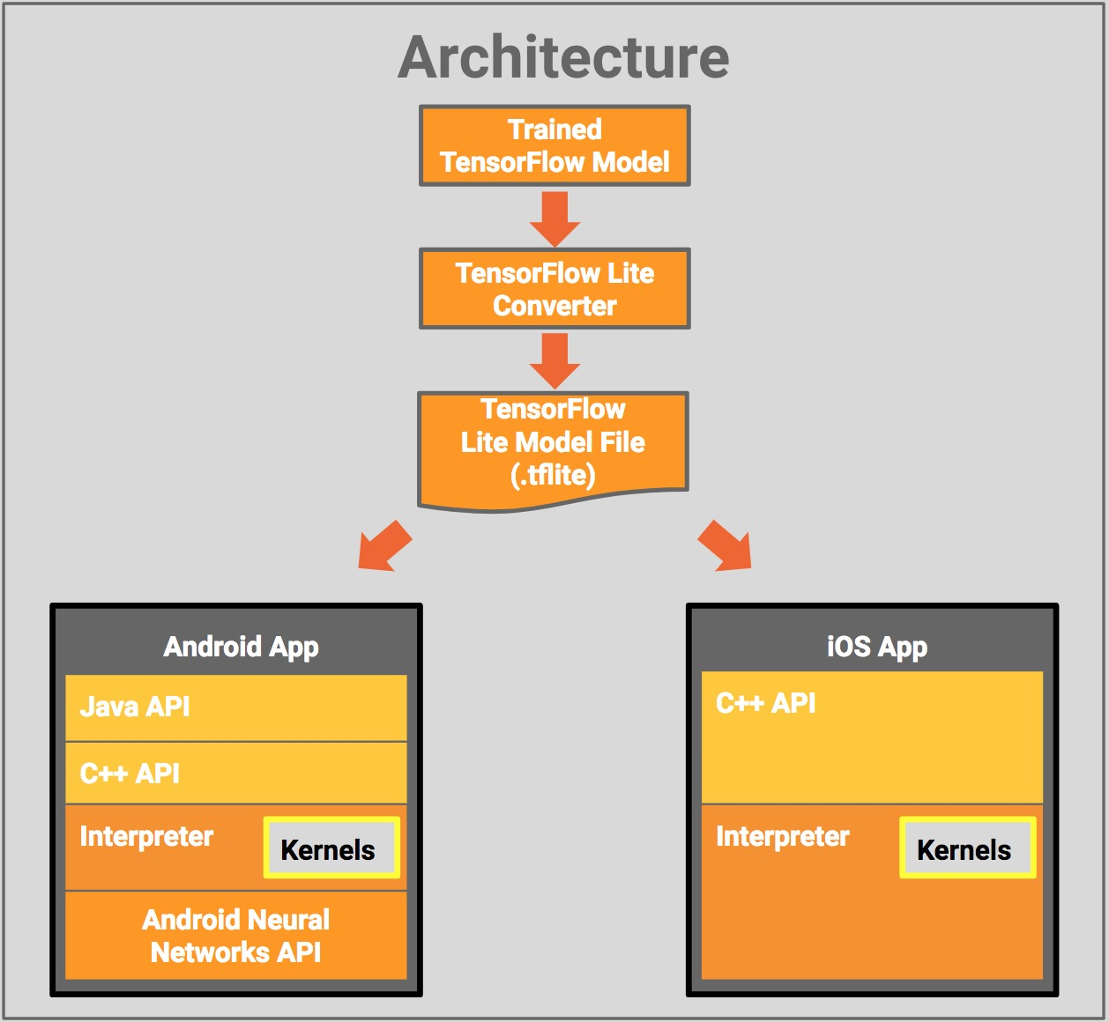
Tflite Usage
TensorFlow Lite API
Python
Android (Java)
Swift
C++

Slide 43
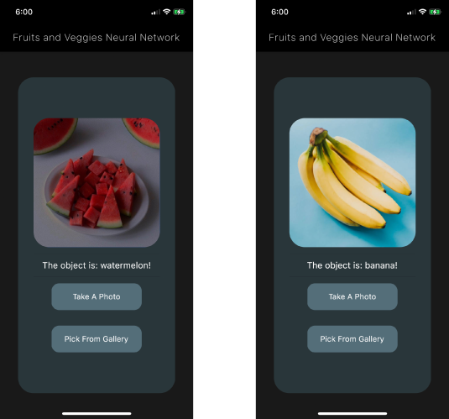
Sample App
https://medium.com/google-cloud/on-device-machine-learning-train-and-run-tensorflow-lite-models-in-your-flutter-apps-15ea796e5ad4

Slide 44
Edge ML
Hands on with Edge Impulse

Slide 45



Keyword Detection on Mobile Phone
What you need:
1 x Computer
1 x Mobile Phone
Internet connection
4 categories: Yes, No, Noise, MLDA
https://docs.edgeimpulse.com/docs/keyword-spotting

Slide 46

Photo Time!

Slide 47
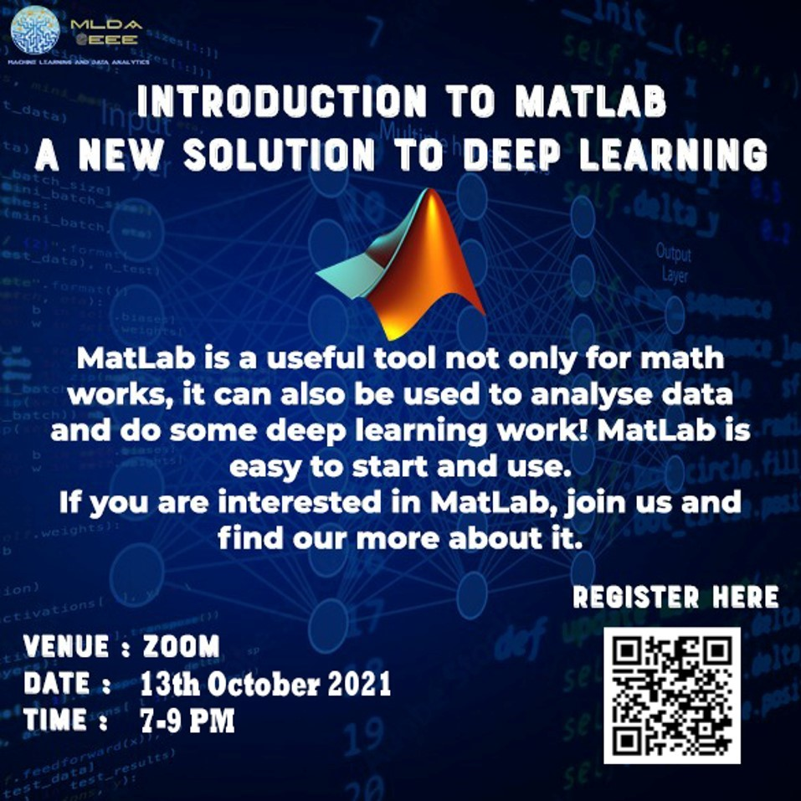

Upcoming Workshops!

Slide 48




We value your Feedback!
https://bit.ly/dlwEdge

